Slide 1
A Quick Guide to the Financial OTC Booking Fee
January 2020

Slide 2
Introduction
The London Metal Exchange (LME) introduced a Financial OTC Booking Fee in March 2018.

Slide 3
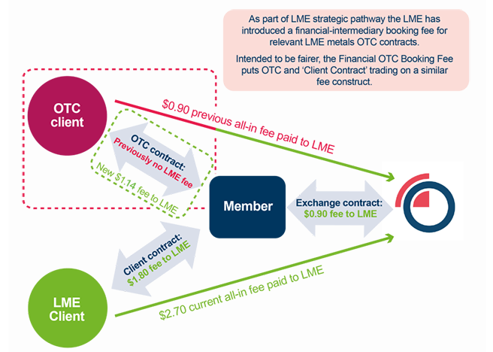
What is the Financial OTC Booking Fee?

Slide 4
What does the Financial OTC Booking Fee policy cover?

Slide 5
What do I need to know?

Slide 6
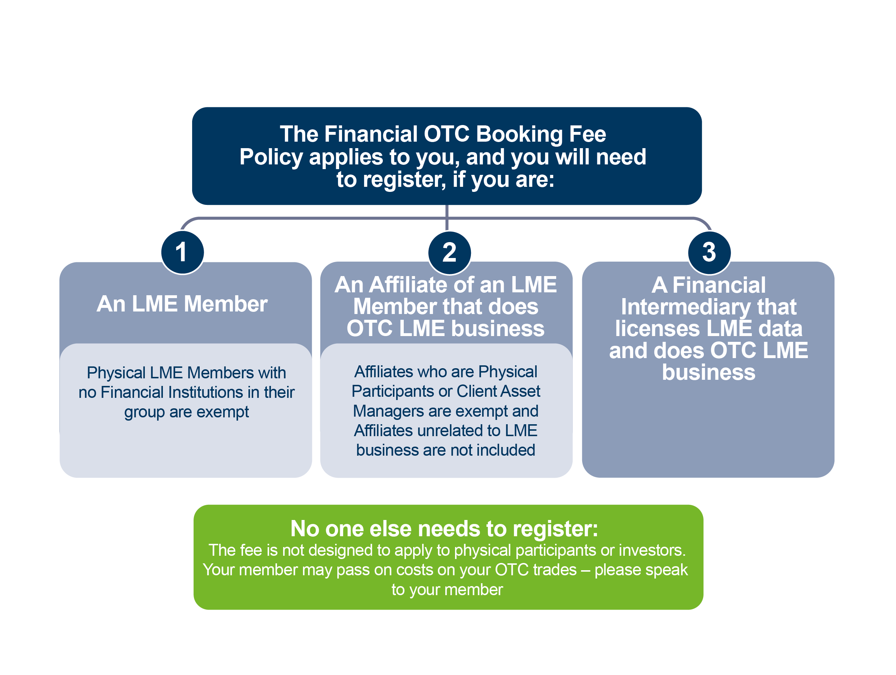
Do I need to register?

Slide 7
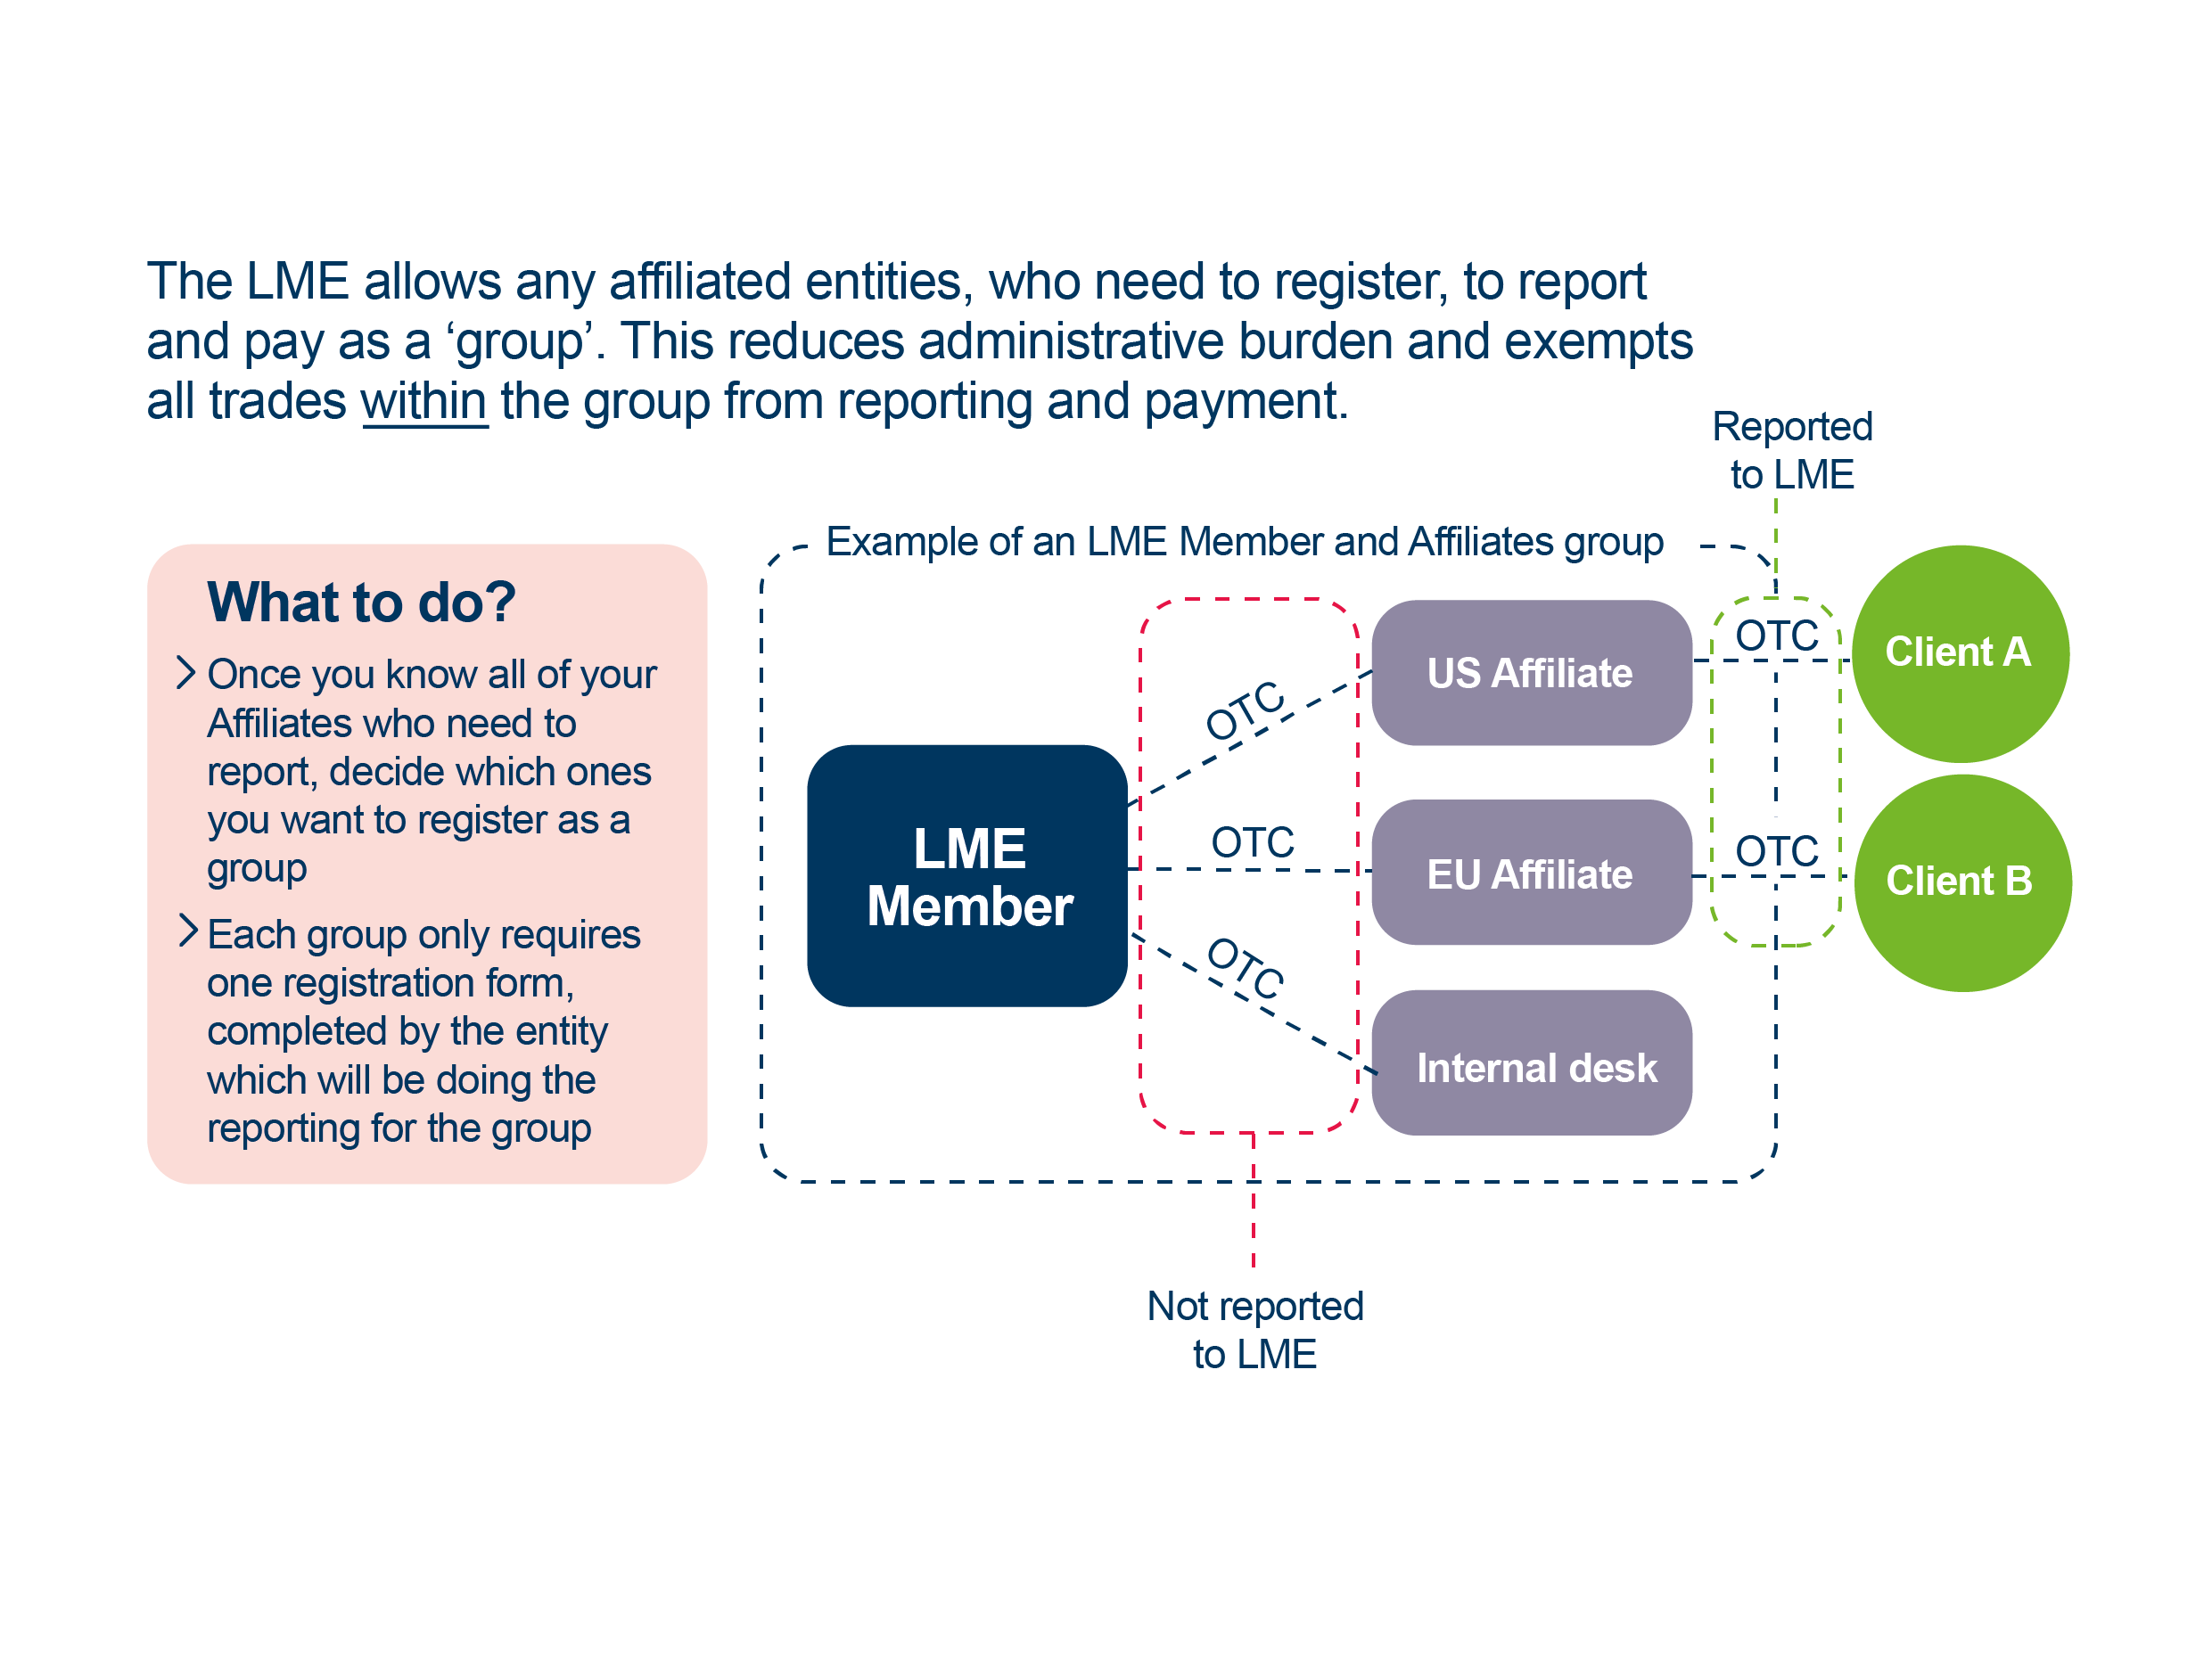
Work out your group structure

Slide 8
Fill out a registration form

Slide 9
Fill out a registration form

Slide 10
Which trades are reported?

Slide 11
How to report

Slide 12
How does the LME calculate what I owe under the new Policy?
General Principle
Financial participants pay $1.14 per lot for each applicable OTC contract (where a Client Contract would have been issued – if available)

Slide 13
Fee payment

Slide 14
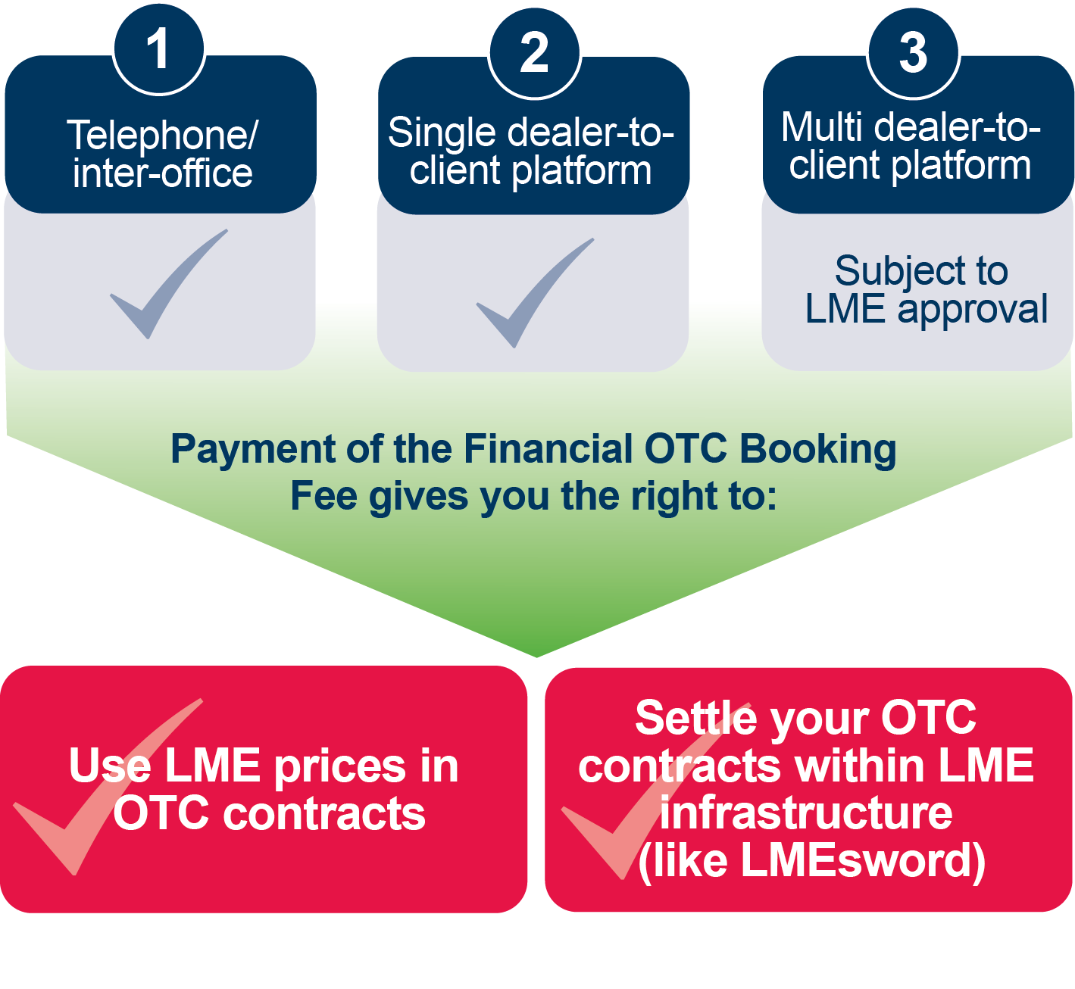
What platforms can I use to create OTC contracts?

Slide 15
Disclaimer
© The London Metal Exchange (the “LME”), 2020. The London Metal Exchange logo is a registered trademark of The London Metal Exchange.
All rights reserved. All information contained within this document (the “Information”) is provided for reference purposes only. While the LME endeavours to ensure the accuracy, reliability and completeness of the Information, neither the LME, nor any of its affiliates makes any warranty or representation, express or implied, or accepts any responsibility or liability for, the accuracy, completeness, reliability or suitability of the Information for any particular purpose. The LME accepts no liability whatsoever to any person for any loss or damage arising from any inaccuracy or omission in the Information or from any consequence, decision, action or non-action based on or in reliance upon the Information. All proposed products described in this document are subject to contract, which may or may not be entered into, and regulatory approval, which may or may not be given. Some proposals may also be subject to consultation and therefore may or may not be implemented or may be implemented in a modified form. Following the conclusion of a consultation, regulatory approval may or may not be given to any proposal put forward. The terms of these proposed products, should they be launched, may differ from the terms described in this document.
The Information is not intended to be a substitute or summary for any consultation document, regulation in the LME’s rules and regulations, nor any policy document proposed or issued by the LME.
Distribution, redistribution, reproduction, modification or transmission of the Information in whole or in part, in any form or by any means are strictly prohibited without the prior written permission of the LME.
The Information does not, and is not intended to, constitute investment advice, commentary or a recommendation to make any investment decision. The LME is not acting for any person to whom it has provided the Information. Persons receiving the Information are not clients of the LME and accordingly the LME is not responsible for providing any such persons with regulatory or other protections. All persons in receipt of the Information should obtain independent investment, legal, tax and other relevant advice before making any decisions based on the Information or any connected consultation document, regulation in the LME’s rules and regulations and any policy document proposed or issued by the LME.
LME contracts may only be offered or sold to United States foreign futures and options customers by firms registered with the Commodity Futures Trading Commission (CFTC), or firms who are permitted to solicit and accept money from US futures and options customers for trading on the LME pursuant to CFTC rule 30.10.

