Slide 1
Backtesting

Slide 2
Backtesting
Introduction
LME Clear executes a number of back tests using different parameters and assumptions.
Where applicable this is performed via factor backtesting and on Clearing Member accounts using portfolio back testing. LME Clear also uses the methodology to back test the performance of collateral haircuts.
LME Clear uses the BASEL traffic light approach (BASEL II coverage test) and Kupiec-POF test to analyse the results of backtesting.
Breaches are analysed and reported through various internal committees such as the Clearing Risk Committee and Financial Risk Working Group on a monthly basis.
At the point at which the number of breaches in a historical look-back period exceeds pre-determined thresholds then this will be immediately escalated to the Clearing Risk Committee with a full explanation and where appropriate, the proposed actions.
A quarterly report is provided to the Board Risk Committees for review and comment.
The results of backtesting will be made available to Clearing Members on a regular basis, see later slides and also through the Risk Advisory Group.

Slide 3
Backtesting
BASEL Traffic Light and Kupiec – POF tests - Generic
The coverage test has been derived from BASEL II practices to estimate the maximum number of breaches allowed per time window.
LME Clear chose a traffic light approach that is derived from the Basel II regulation Annex 10a (page 315) which defines three zones; Green, Yellow and Red.
The Basel Traffic Light approach uses a yellow zone beginning at the confidence interval at 95% of not achieving the stated margin methodology. The red zone begins at the point such that the probability exceeds 99.99%.
Instead of calculating the start of the red zone as defined by the Basel approach, LME Clear utilises the more conservative Kupiec-POF test at a 99% confidence interval to provide a more statistically robust measure.
LME Clear calculates the sum of breaches allowed per time window derived from the rules above.

Slide 4
Backtesting
Factor Margin Backtesting
LME Clear performs the backtesting of all SPAN margin parameters on a daily basis using one and two day returns over a period covering all available price history.
Both 1-day and 2-day returns are calculated per risk factor.
A “breach” is recorded in case the margin parameter – on a specific date – is not sufficient to cover either the respective 1-day or the 2-day returns occurring during the whole liquidation period.
The Liquidation Period is defined as the number of business days within which – in case a Member defaults – all portfolio’s positions have to be closed, auctioned or ported. Currently, the liquidation period is 2 business days.
Margin/haircut parameters are compared to the absolute size of forward calculated returns, mirroring what would happen in the event of a Member default where LME Clear Initial Margin/collateral would need to cover the price moves on the subsequent days.
The number of breaches per risk factor is compared against the Traffic Light Thresholds (given the number of observations).
Traffic Light thresholds are expected to change over time due to the increase in sample size.

Slide 5
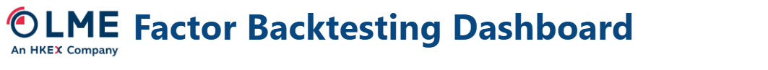
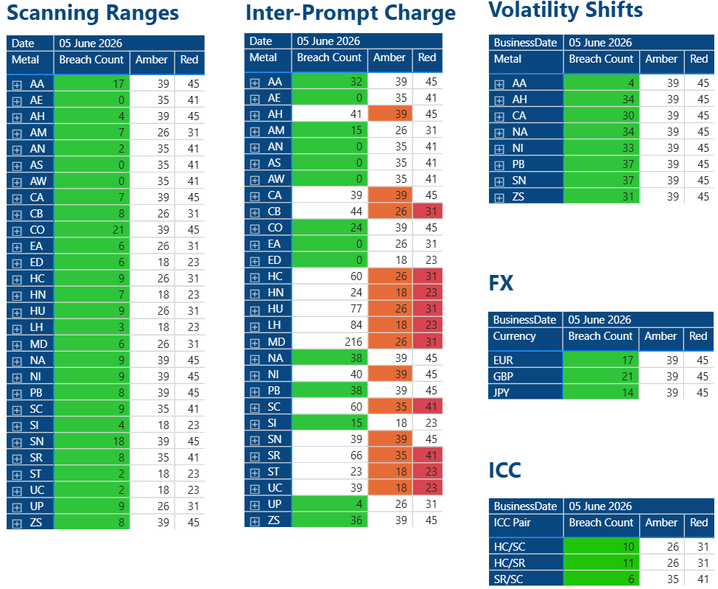
Backtesting
Factor Margin Backtesting – June 2026 results
The table below summarises the results, showing worst case number of breaches.
  Material parameters are in the green threshold. Aluminum, Copper, Nickel, Lead and Tin Inter-Prompt Charges are in amber for some tier combinations. Overall impact is not material and majority of breaches are from historical periods.
  LMEC are in amber/red for some more immaterial contracts, due to a combination of illiquidity and lack of pricing history. The majority of these contracts have no open interest or overall exposures and not material.

Slide 6
Backtesting
Portfolio Margin Backtesting
The LME Clear risk appetite states that LME Clear’s margining model seeks to ensure that at each position account level a minimum 99.5% of observed losses will be less than the initial margin held.
LME Clear performs daily portfolio backtesting on all Members, for each position account and use a margin period of risk to combine 1 and 2 day breaches
All portfolio backtesting will use the available history on each account to analyse backtesting results.
For any new Member accounts, LME Clear will analyse and report on any breaches. However a minimum number of data points are required for the account level portfolio backtesting to be statistically relevant. LME Clear deems 250 data points to be sufficient.
Portfolio Margin Backtesting assumptions
While analysing the backtesting results, the known SPAN margin algorithm limitations will be taken into account. Where breaches at an account level are caused by a known limitation, which are managed outside of the Initial Margin calculation, these will be documented. This may require no action to be taken or new model proposed, even if the number of breaches falls into the Red threshold.
While the backtesting data will use a significant and realistic spread of real portfolios covering a substantial range of instruments and strategies, LME Clear will identify specific hypothetical strategies to prove the effectiveness of the algorithm and backtest these in conjunction with real portfolios.
For the purpose of further validating the model LME Clear has included fixed representative portfolios within the analysis. This allows LME Clear to perform some relevant statistical analysis.

Slide 7
Backtesting
Portfolio Backtesting – June 2026 results
Portfolio backtesting, across all material portfolios, are in the green threshold.

Slide 8
Backtesting
Collateral Backtesting
Member collateral back testing follows the same reporting and governance process as cleared positions.
Back testing performed in 2 areas;
    Risk Factor; Securities – zero coupon curves with volatility converted to prices, Gold – spot prices, FX – spot rates, LME Warrants – cash price
    Member Portfolio – Position account level, clean portfolio
Results measured on same Basel II combined with Kupiec-POF basis as margin collateral against a 99.5% confidence level
Backtesting results can be captured for each Risk Factor once sufficient historical data is available so that haircuts can be modelled based on the current methodology

Slide 9
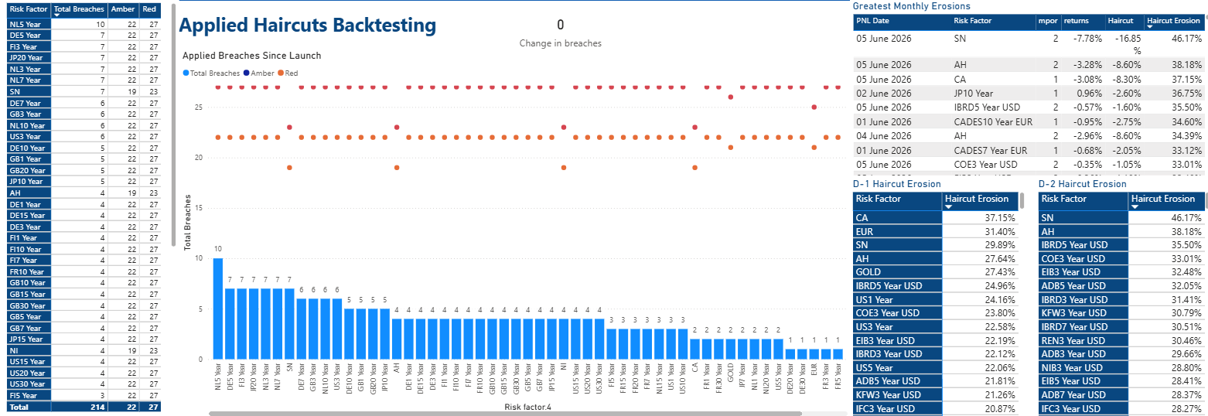
Backtesting
Factor Margin Collateral Backtesting – June 26 Results
The table summarises the results of Margin Collateral Risk Factor Backtesting breaches per test and by time series
All acceptable margin collateral is currently classified as GREEN per the BINOMIAL /KUPIEC back testing thresholds.

