Slide 1






30th September 2024
Natalie Scott-Gray

Slide 2


Natalie Scott-Gray is a full-time employees of StoneX Financial Ltd. She does not have personal trading account.
This communication is issued in the European Economic Area by StoneX Financial Europe S.A.
© 2024 StoneX Group Inc (SGI) all rights reserved. The StoneX Group of companies provides financial services worldwide, including physical commodities, securities, exchange-traded futures and options, OTC instruments, risk management and advisory services, global payments and foreign exchange products, in accordance with applicable laws in the jurisdictions where services are provided. References to certain OTC products or swaps are made on behalf of StoneX Markets, LLC (SXM), a member of the National Futures Association (NFA) and provisionally registered with the U.S. Commodity Futures Trading Commission (CFTC) as a swap dealer. SXM’s products are designed only for individuals or firms who qualify under CFTC rules as an ‘Eligible Contract Participant’ and who have been accepted as customers of SXM.
StoneX Financial Inc. (SFI) is a member of FINRA/NFA/SIPC and registered with the MSRB. SFI is registered with the U.S. Securities and Exchange Commission (SEC) as a Broker-Dealer and with the CFTC as a Futures Commission Merchant and Commodity Trading Advisor. References to certain securities trading are made on behalf of the BD Division of SFI and are intended only for an audience of institutional clients as defined by FINRA Rule 4512(c). References to certain exchange-traded futures and options are made on behalf of the FCM Division of SFI. Wealth Management is offered through SA Stone Wealth Management Inc., member FINRA/SIPC, and SA Stone Investment Advisors Inc., an SEC-registered investment advisor, both wholly owned subsidiaries of SGI.
StoneX Financial Ltd (SFL) is registered in England and Wales, company no. 5616586. SFL is authorised and regulated by the Financial Conduct Authority (FCA) (registration number FRN:446717) to provide services to professional and eligible customers including: arrangement, execution and, where required, clearing derivative transactions in exchange traded futures and options. SFL is also authorised to engage in the arrangement and execution of transactions in certain OTC products, certain securities trading, precious metals trading and payment services to eligible customers. SFL is authorised and regulated by the FCA under the Payment Services Regulations 2017 for the provision of payment services. SFL is a category 1 ring-dealing member of the London Metal Exchange. In addition SFL also engages in other physically delivered commodities business and other general business activities which are unregulated and not required to be authorised by the FCA.
StoneX Financial Europe S.A. (SFE) is a securities trading firm registered in the Grand Duchy of Luxembourg under Company No. RC Lux B 10821. SFE is authorised by the Luxembourg Ministry of Finance and regulated by the Commission de Surveillance du Secteur Financier (registration no. P00000012) to carry out, inter alia, the activities of investment adviser, portfolio manager, professional acting on own account, broker in financial instruments, and commission agent.
StoneX Financial GmbH, entered in the Frankfurt am Main Commercial Register, HRB 101212 with seat in Frankfurt am Main, is authorised to perform payment services (Finanztransfergeschäft) in accordance to § 1. PAR 1 sentence 2 No. 6 German Payment Act (ZAG) and is regulated by the Federal Financial Supervisory Authority (Bundesanstalt für Finanzdienstleistungsaufsicht- BaFin) and the German Federal Bank (Deutsche Bundesbank- BuBa) under the register number BaFin-ID: 10141964.
StoneX Financial Europe GmbH, entered in the Hamburg Commercial register, HRB 80844 with seat in Hamburg, is listed in the Federal Financial Supervisory Authority (Bundesanstalt für Finanzdienstleistungsaufsicht- BaFin) register to carry out the following activities: a) trade in commodities (in particular metals),
b) arrange transactions for metals and commodities with dealers, producers or commercial users of the commodities, and c) provide investment brokerage for financial instruments in accordance with § 2 Para. 10 KWG respectively § 3 Para. 2 WpIG exclusively in the name, under liability and for the account of StoneX. Its status as tied agent does not require authorisation by the BaFin.
StoneX Financial Pte. Ltd. (Co. Reg. No. 201130598R) (“SFP”) is regulated by the Monetary Authority of Singapore and is a Capital Markets Service Licensee (for dealing in capital market products), an Exempt Financial Adviser (for advising on investment products and issuing or promulgating analyses/ reports on investment products) and a Major Payment Institution (for cross-border money transfer service).
StoneX APAC Pte. Ltd. (“SAP”) (Co. Reg. No 200616676W) is regulated as a Dealer (PS20190001002) under the Precious Stones and Precious Metals (Prevention of Money Laundering and Terrorism Financing) Act 2019 for purposes of anti-money laundering and countering the financing of terrorism. SAP is an
“Approved International Trading Company” authorized to act as a “Spot Commodity Broker” under the Commodity Trading Act.
StoneX Financial (HK) Limited (CE No.: BCQ152) (“SHK”) is regulated by the Hong Kong Securities and Futures Commission for Dealing in Securities and Dealing in Futures Contracts.
StoneX Financial Pty Ltd (“SFA”) (ACN: 141 774 727) holds an Australian Financial Service License and is regulated by the Australian Securities and Investments Commission (AFSL: 345646).
StoneX Securities Co., Ltd. (“SSJ”) (Co. Reg. No 010401047199) is regulated by the Japanese Financial Services Agency as a Type-I Financial Instruments Business Operator (Kanto Local Finance Bureau (FIBO)No.291’), is a member of the Financial Futures Association of Japan for dealing and broking FX and FX Option
transactions, and is a member of the Japan Securities Dealers Association for dealing and broking stock indices and option transactions.
StoneX Financial Nigeria Ltd. (company registration number RC 1157178) is regulated as a broker-dealer by the Securities and Exchange Commission of Nigeria and licenced by the Nigerian Stock Exchange, NASD Plc, and FMDQ Securities Exchange. StoneX Commodities DMCC (company registration number DMCC 30630) holds DMCC Licences (DMCC 31371 and DMCC 30630) for non-manufactured precious metals trading and metal ores trading.
Trading swaps and OTC derivatives, exchange-traded derivatives and options, securities and other financial products involves substantial risk and is not suitable for all investors. The information herein is not advice nor a recommendation to trade nor an offer to buy or sell any financial product or service. It does not take into account your particular investment objectives, financial situation or needs and does not create a binding obligation on any of the StoneX Group of companies to enter into any transaction with you. You should perform an independent investigation of any transaction to determine whether it is suitable for you. No part of this material may be copied, photocopied or duplicated in any form by any means or redistributed without the prior written consent of SGI. This document and the information herein is provided confidentially for information purposes only to the recipient. This information is provided on an ‘as-is’ basis and may contain statements and opinions of the StoneX Group as well as excerpts and/or information from public sources and third parties and no warranty, whether express or implied, is given as to its completeness or accuracy. Each company within the StoneX Group (on its own behalf and on behalf of its directors, employees and agents) disclaims any and all liability as well as any third-party claim that may arise from the accuracy and/or completeness of the information detailed herein, as well as the use of or reliance on this information by the recipient, any member of its group or any third party.

Slide 3




Slide 4
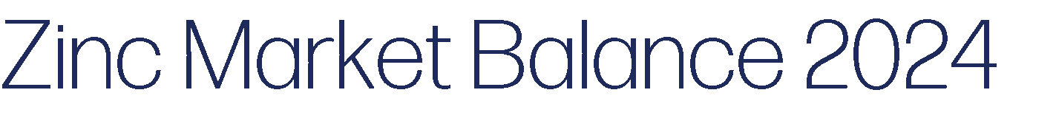

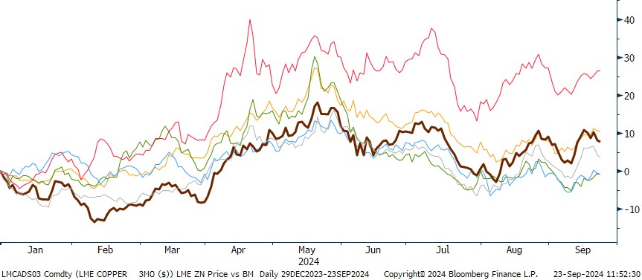

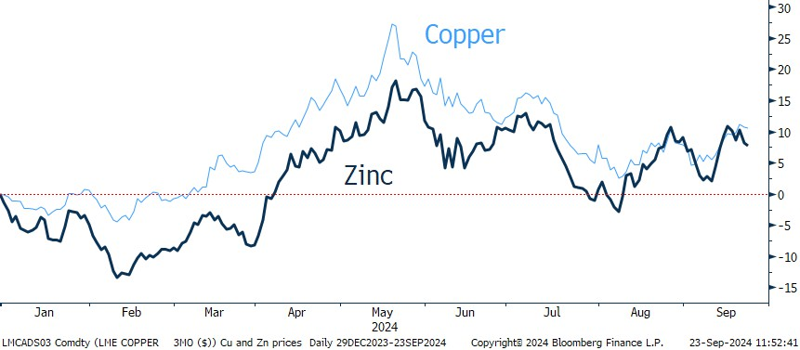
Tin
Copper
Zinc
Aluminium
Lead
Nickel
400
300
200
000t
Source: Bloomberg, StoneX
100
0
2024 (LME Week 2023) 2024F
This table includes predictions/forecasts. Past performance may not be a reliable guide to future performance.
Source: Bloomberg; SMM, ILZG, StoneX
Source: Bloomberg, StoneX

Slide 5




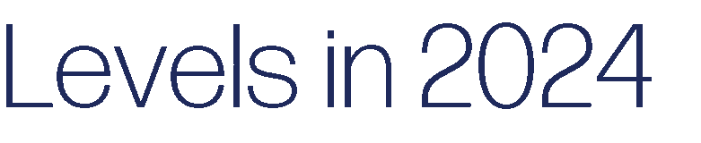

China
Ex-China
Global (LHS)
Zinc Concentrate
Refined Zinc
8%
13,200
6%
12,800
120
4%
12,400
80
2%
000t
40
0%
12,000
%
11,600
0
-2%
-40
-4%
2021
2022
2023
2024F
2025F
11,200
-80
Dec-23
Feb-24
Apr-24
Jun-24
Aug-24
This table includes predictions/forecasts. Past performance may not be a reliable guide to future performance.
Source: Bloomberg; SMM, ILZG, StoneX
Source: Bloomberg, StoneX
China
Ex-China
Global (LHS)
350
12%
14,400
300
8%
250
14,000
200
4%
000t
$/t
150
13,600
0%
100
13,200
50
-4%
0
-8%
12,800
Jan-09
Jan-12
Jan-15
Jan-18
Jan-21
Jan-24
2021 2022 2023 2024F 2025F
Source: Bloomberg, StoneX
This table includes predictions/forecasts. Past performance may not be a reliable guide to future performance.
Source: Bloomberg; SMM, ILZG, StoneX

Slide 6



Zinc Oxide &
Chemicals
9%
5%
China
Ex-China
Global (LHS)
Zinc Semi
13%
12%
14,400
Alloys (Cu)
Alloys (Die-Cast)
60%
8%
13%
14,000
Galvanising
Source: Bloomberg, StoneX
4%
13,600
000t
2022 2023 2024F
0%
8.0%
4.0%
1.8%
1.6%
1.3%
13,200
0.5%
0.2%
-4%
0.0%
-4.0%
-2.1%
-8%
12,800
-8.0%
2021
2022
2023 2024F
2025F
-12.0%
Others Battery Brass
Refined Zn
demand
Galvanized Zn oxides
steel
This table includes predictions/forecasts. Past performance may not be a reliable guide to future performance.
This table includes predictions/forecasts. Past performance may not be a reliable guide to future performance.
Source: Bloomberg; SMM, ILZG, StoneX
Source: Bloomberg; SMM, ILZG, StoneX

Slide 7
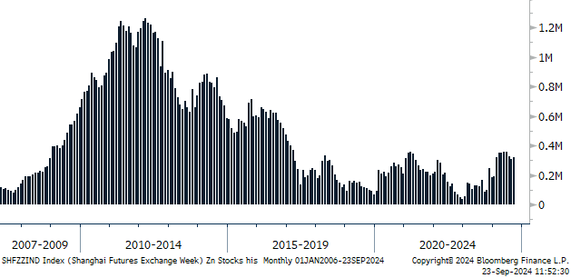





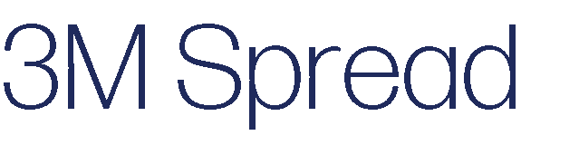
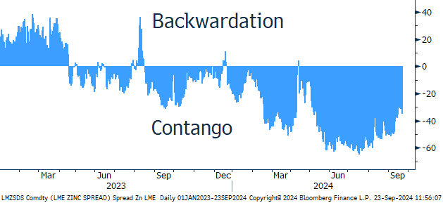
350
300
250
200
150
100
50
314
 |  |  |  | 154 130
 |  |  |  | 47
 | -54
Source: Bloomberg, StoneX
1.5
000t
1.0
Weeks
0.5
0
-50
-100
0.0
2020
2021
2022
2023 2024F
Source: Bloomberg, StoneX
2022 2024F 2026F
This table includes predictions/forecasts. Past performance may not be a reliable guide to future performance.
Source: Bloomberg; SMM, ILZG, StoneX
Source: Bloomberg, StoneX

Slide 8

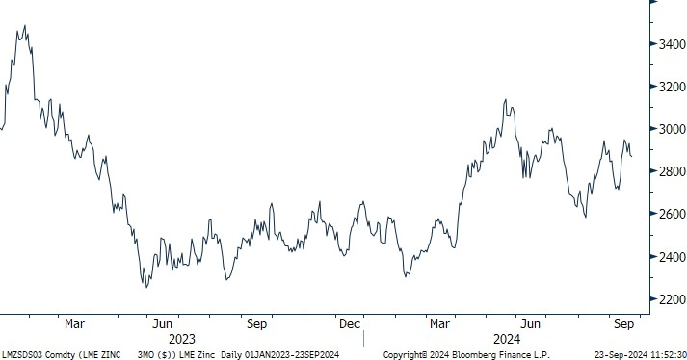
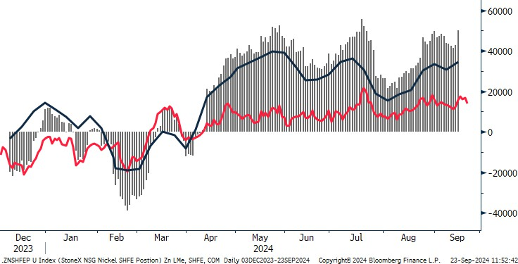
Tight ore supply and seasonality demand factors (in China) will likely support higher zinc prices to year-end. While forecast increased investment into infrastructure and construction globally, set against a backdrop of supply challenges, will encourage higher average LME zinc prices in 2025.
Source: Bloomberg, StoneX
Mine supply is on a path to recovery in 2025, with the opening of new mining projects, while refined output will increase alongside expanding Chinese smelter capacity, cushioned by ex-China inventory.
Total
LME
SHFE
Zinc’s demand prospects (with 60% exposure to galvanising steel) will be highly dependent on the outcome of external variables in 2025, especially on governmental policy within the US and China. This has the outcome to derail our forecasts.
Source: Bloomberg, StoneX

Slide 9


Slide 10
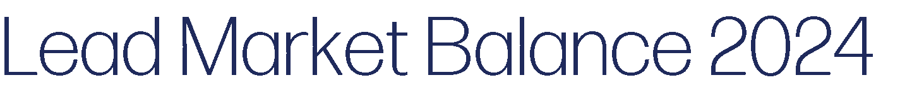

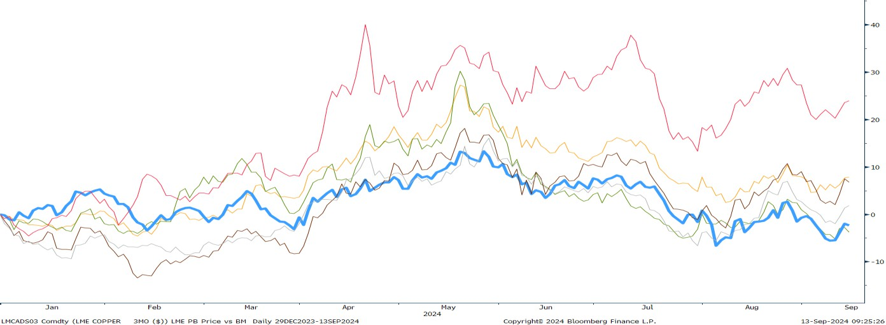



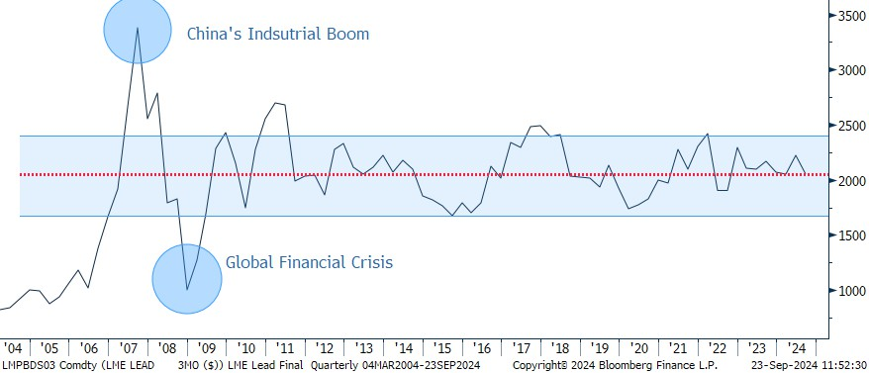
Tin
Copper
Zinc
Aluminium
Lead
Nickel
160,000
120,000
116,000
t
80,000
44,000
40,000
Source: Bloomberg, StoneX
0
2024 (LME Week 2023) LME Week 2024
This table includes predictions/forecasts. Past performance may not be a reliable guide to future performance.
Source: Bloomberg; SMM, ILZG, StoneX
Summary
Lead is likely to remain on a less volatile path than the rest of the base metal suite due to its unique characteristics:
Its lower exposure to primary supply risks
Its lower exposure to primary demand risks
Smaller market imbalances
Relative illiquidity
Commonly misunderstood long-term role in decarbonisation
Source: Bloomberg, StoneX

Slide 11
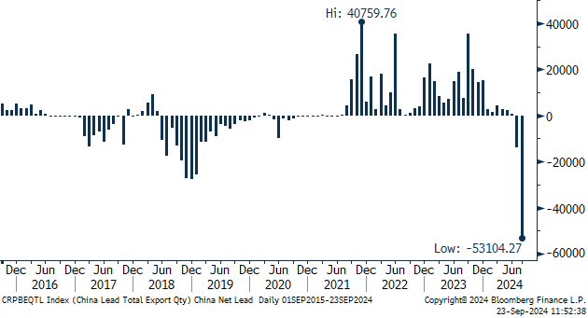



China
Ex-China
Global
3%
4,800
1%
-1%
4,400
000t
-3%
-5%
2022
2023
2024F
2025F
4,000
This table includes predictions/forecasts. Past performance may not be a reliable guide to future performance.
Source: Bloomberg; SMM, ILZG, StoneX
Source: Bloomberg, StoneX
200
180
160
140
120
100
80
60
40
20
0
China
Ex-China
Global
6%
13,600
4%
$/t
2%
13,200
000t
0%
12,800
-2%
Jan-09
Jan-12
Jan-15
Jan-18
Jan-21 Jan-24
Source: Bloomberg, StoneX
-4% 12,400
2022 2023 2024F 2025F
This table includes predictions/forecasts. Past performance may not be a reliable guide to future performance.
Source: Bloomberg; SMM, ILZG, StoneX

Slide 12







Pb-Acid Battery (Industrial)
China
Ex-China
Global
Pb-Acid Battery
(Replacement)
4%
13,600
Pb-Acid Battery (Original Equipment)
Non-Battery
2%
13,200
Source: Bloomberg, StoneX
%
000t
Demand
Annual % Change
0%
12,800
800
12.0%
750
10.0%
700
8.0%
00t
650
6.0%
-2%
12,400
600
4.0%
2022
2023
2024F
2025F
550
2.0%
500
2021
2023
2025F
2027F
0.0%
This table includes predictions/forecasts. Past performance may not be a reliable guide to future performance.
Source: Bloomberg; SMM, ILZG, StoneX
This table includes predictions/forecasts. Past performance may not be a reliable guide to future performance.
Source: Bloomberg; SMM, ILZG, StoneX

Slide 13
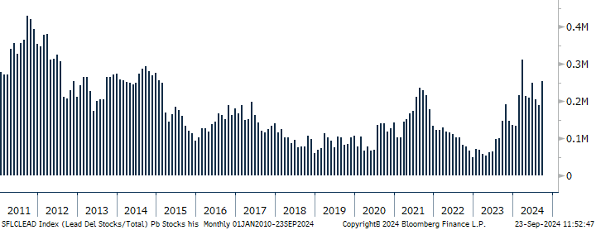


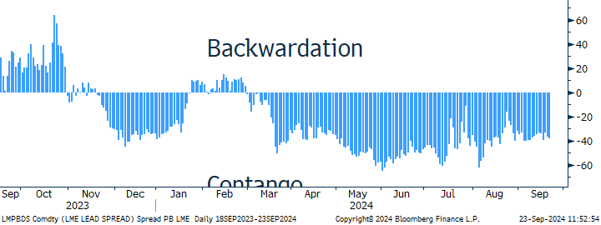
150
102
100
Source: Bloomberg, StoneX
50
44
39
1.5
0
000t
1.0
-50
-33
Weeks
0.5
-100
0.0
2020
2021
2022
2023
2024F
Source: Bloomberg, StoneX
-150
-167
2022 2024F 2026F
This table includes predictions/forecasts. Past performance may not be a reliable guide to future performance.
Source: Bloomberg; SMM, ILZG, StoneX
-200
Source: Bloomberg, StoneX

Slide 14

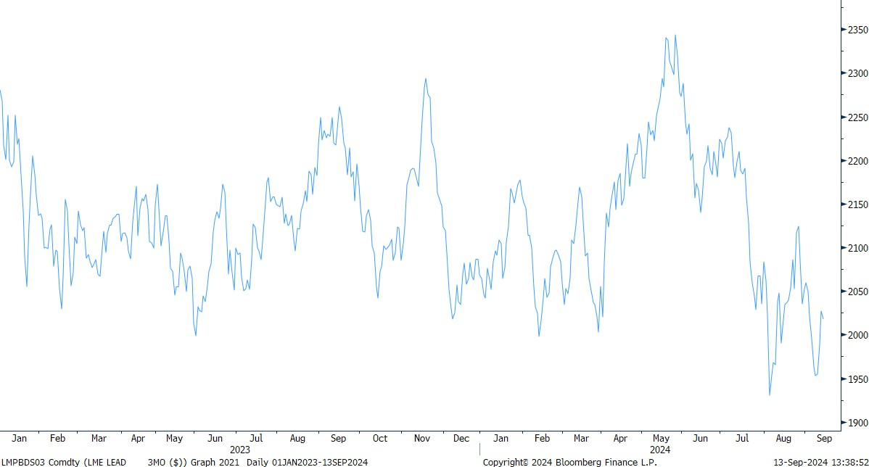
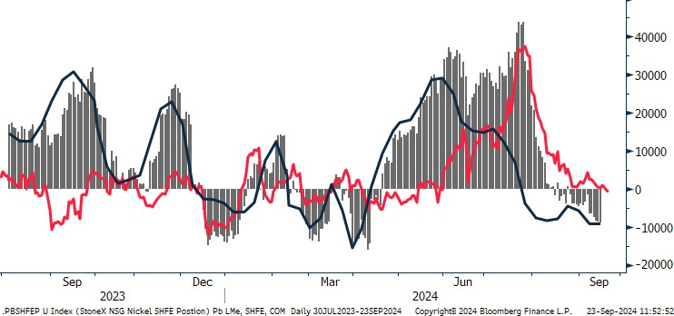
Macro tailwinds amid modest fundamentals are set to result in marginally higher average LME prices for lead in 2025 compared to 2024.
Regional market imbalances will start to unwind in 2025, with ex-China excess material creating a cushion for Chinese tightness; however, we do not rule out another short squeeze in the near-term.
Battery replacement will continue to outstrip OE demand, however, we forecast a resumption in consumer spending from current levels, aided by regional Governmental policy.
Source: Bloomberg, StoneX
Total
LME
SHFE
Lead to be part of the solution towards decarbonation goals, alongside (not against) lithium-ion batteries.
Lead prices to remain on a less volatile path than the rest of the base metal suite due to its lower exposure to supply risks, smaller market imbalances, relative illiquidity and misunderstood long-term role in decarbonisation (weakening future investor sentiment).
Source: Bloomberg, StoneX

Slide 15
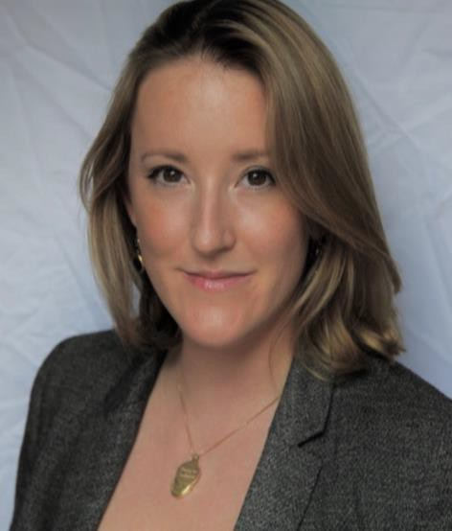
StoneX Connects.
Natalie Scott-Gray
THANK YOU
Senior Metals Analyst Base Metals
Office: +44 (0)203 580 6544
Mobile: +44 (0) 7384 833895
Email: natalie.scott-gray@stonex.com

Slide 16
